Slide 1
ANSYS PROJECT: Python API for Modeling Integrated Electro-Optic Modulators in Lumerical
AUGUST 11TH,2023
SUNGHWAN BAEK

Slide 2
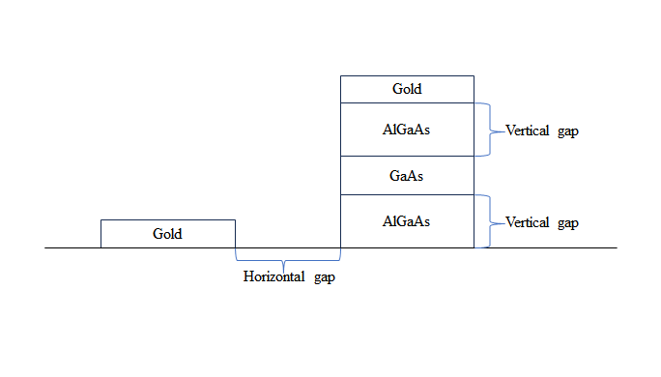
Goal
The primary objective of this project is to construct a structure made of gold, AlGaAs, and GaAs. The project focused on gathering loss data from the GaAs waveguide, varying vertical and horizontal gaps. The ultimate aim is to meticulously identify and establish the optimal vertical and horizontal gap parameters that result in minimal loss.

Slide 3
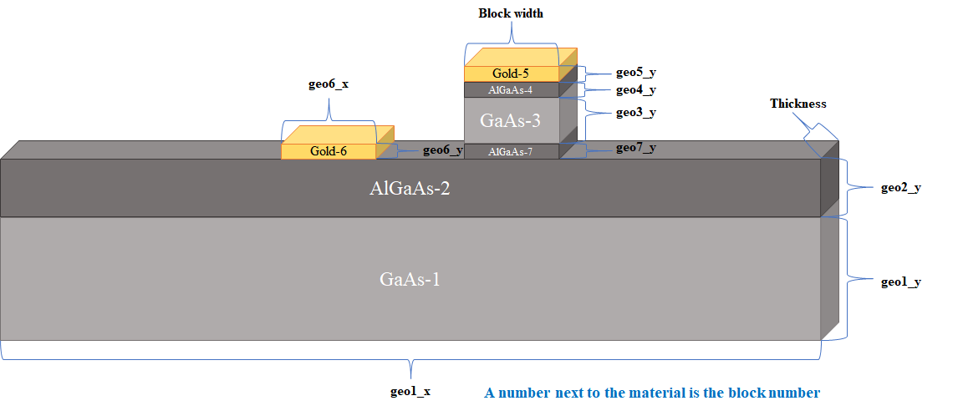
settings.py
I provided settings.py for users to control the structure of the blocks
All information in the images are saved as variables in settings.py.
Users can change the size of blocks and material if they want by simply changing the variables.

Slide 4
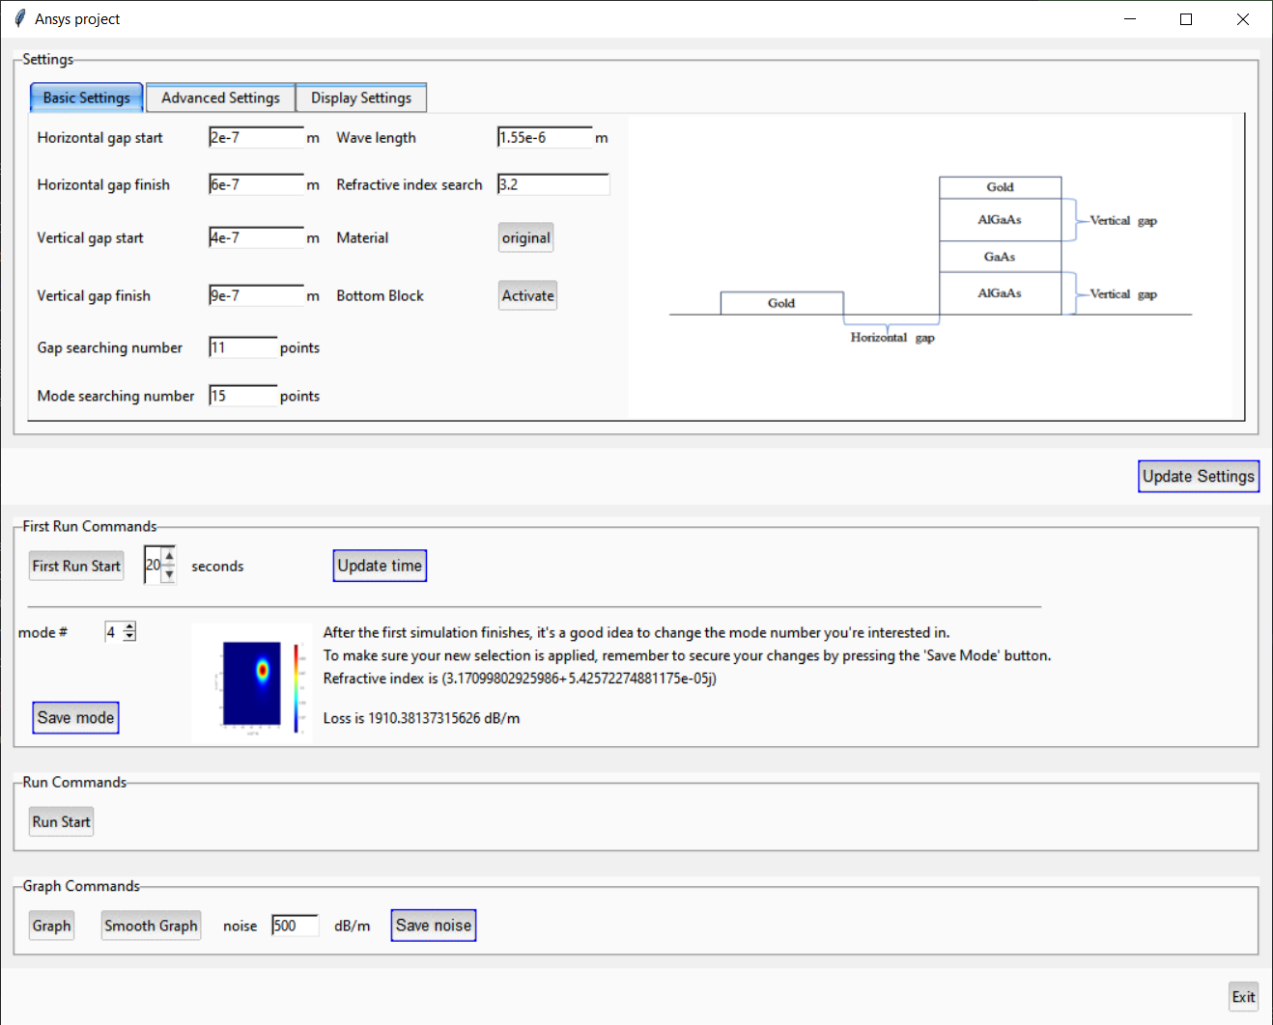
GUI
settings.py can be controlled by the Tkinter user interface
By using the Tkinter user interface, users can understand the current settings of the blocks, and they can easily change the settings and press ‘Update Settings’ to update variables in the settings.py.

Slide 5
GUI
settings.py can be controlled by the Tkinter user interface
After finishing the ‘First Run Start,’ mode data are saved, and the user can see the image, refractive index, and loss information on the Tkinter user interface. In the previous experiment, 15 different mode data were saved, and the user could see the modes’ information on the Tkinter user interface. By clicking ‘Save mode,’ the selected mode data will be used to find loss data.

Slide 6
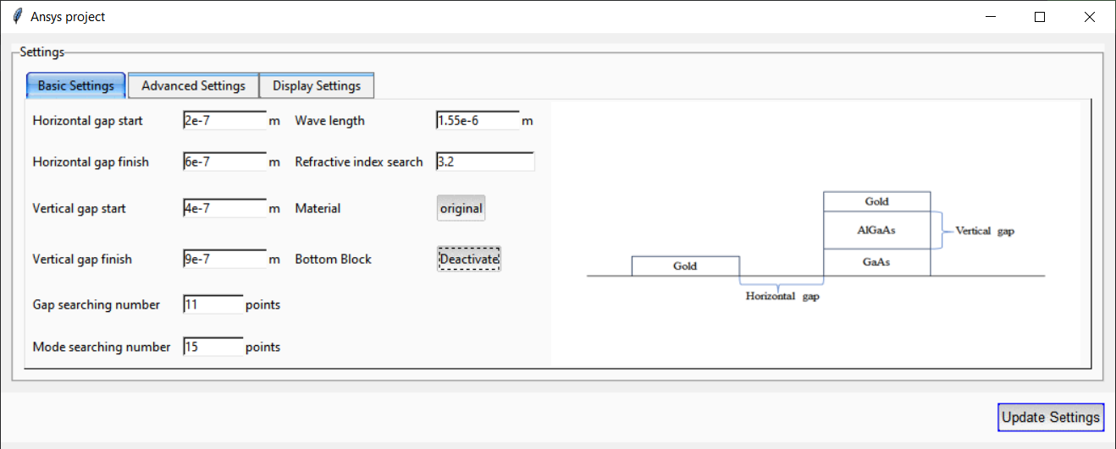
GUI
Bottom block can be deactivated
For example, If the user clicks the ‘Deactivate’ button, then the image of the user interface changes, and the user can see how the bottom block is deactivated. By updating the setting, now Ansys program will simulate blocks without the bottom block.

Slide 7
GUI
It is an all-in-one user interface
After finishing ‘Run Start’ on the user interface, a result file will be automatically made in ‘result’ folder. By clicking ‘Graph’ button, the most recent graph will be displayed automatically. ‘Smooth Graph’ button makes graphs with interpolation applied and user can add noise to the loss/m.

Slide 8
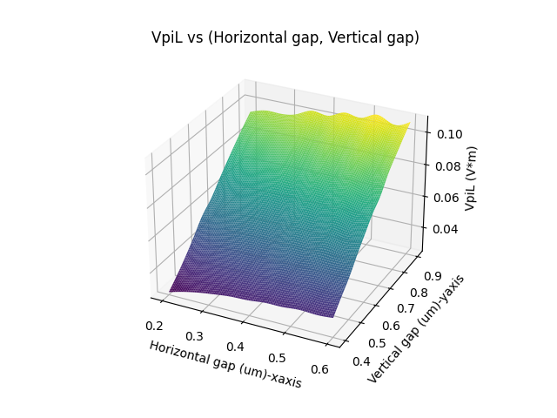
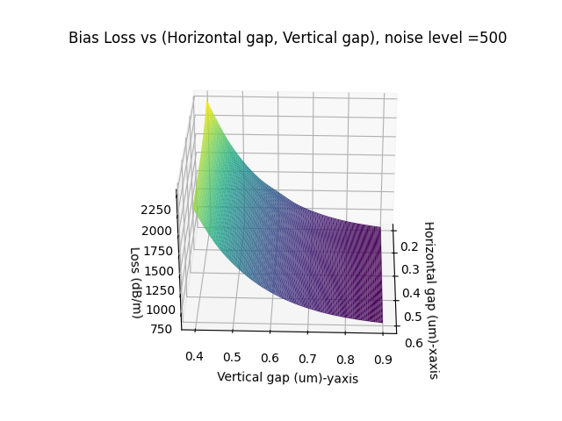
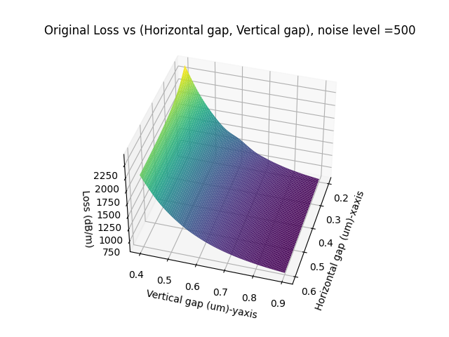
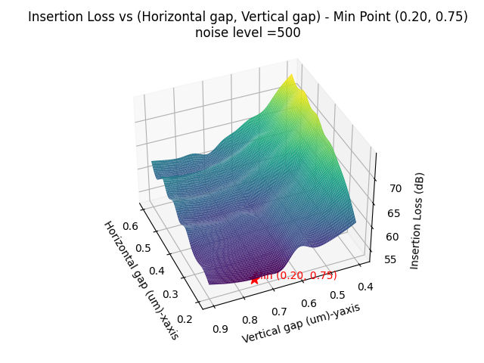
GUI
It is all-in-one user interface
These graphs are achieved from the ‘Smooth graph.’ In the Insertion Loss graph, the Minimum point automatically displayed it is (0.20, 0.75). I used original material, so I added noise to the model to make it realistic. Users also can adjust noise depending on their needs and experiment setup.

Slide 9
Mode Selector
Using one selected mode, algorithm continuously updates the mode shape
Before I made this new algorithm, finding mode relied on the one mode shape.
If Horizontal or vertical gap changes, the overall shape of mode also changed.
During the project, if there were two similar looking modes, sometimes program mistakenly choose the wrong mode.

Slide 10
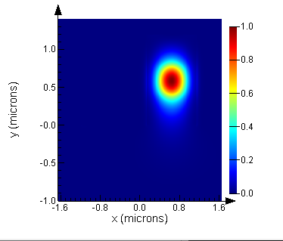
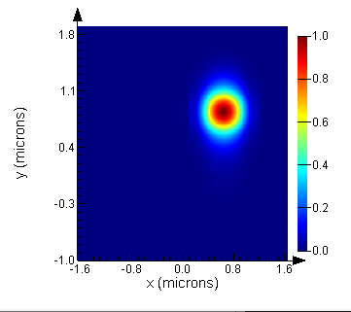
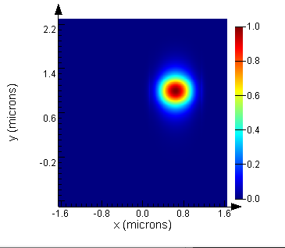
Mode Selector
The position and shape of the modes changes and it makes the mode finding algorithm venerable. Therefore, mode should be updated after each iteration.

Slide 11
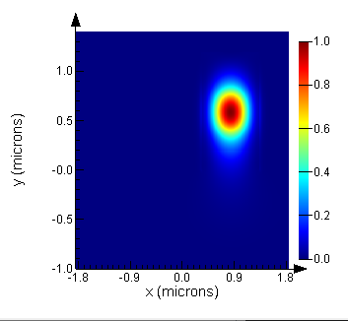
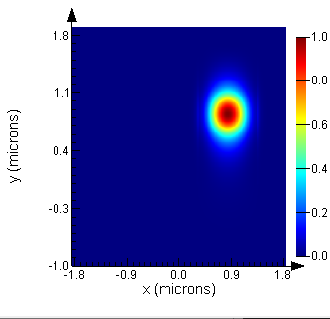

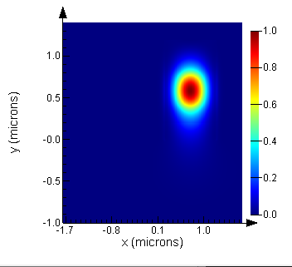
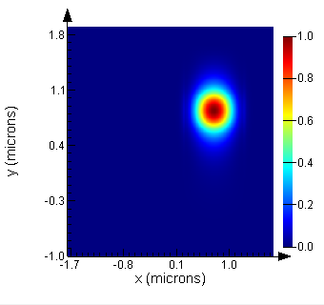
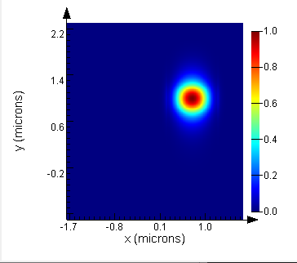
Algorithm explained
The blue arrow's direction represents the mode referencing direction. The start point of the arrow indicates where the algorithm references the mode from. The data from the previous row or column mode are used to find the current set of modes, and I programmed the algorithm to save the best overlap mode of the last mode to the d-card for the subsequent mode finding.
: means, the current mode used the previous row’s mode to get the best overlap mode. Because of the algorithm structure, an alteration in a row can only occur once modifications have been fully applied to all columns.
Increase in horizontal
gap
: means, the current mode used the previous column’s mode to get the best overlap mode.
Increase in vertical gap

Slide 12
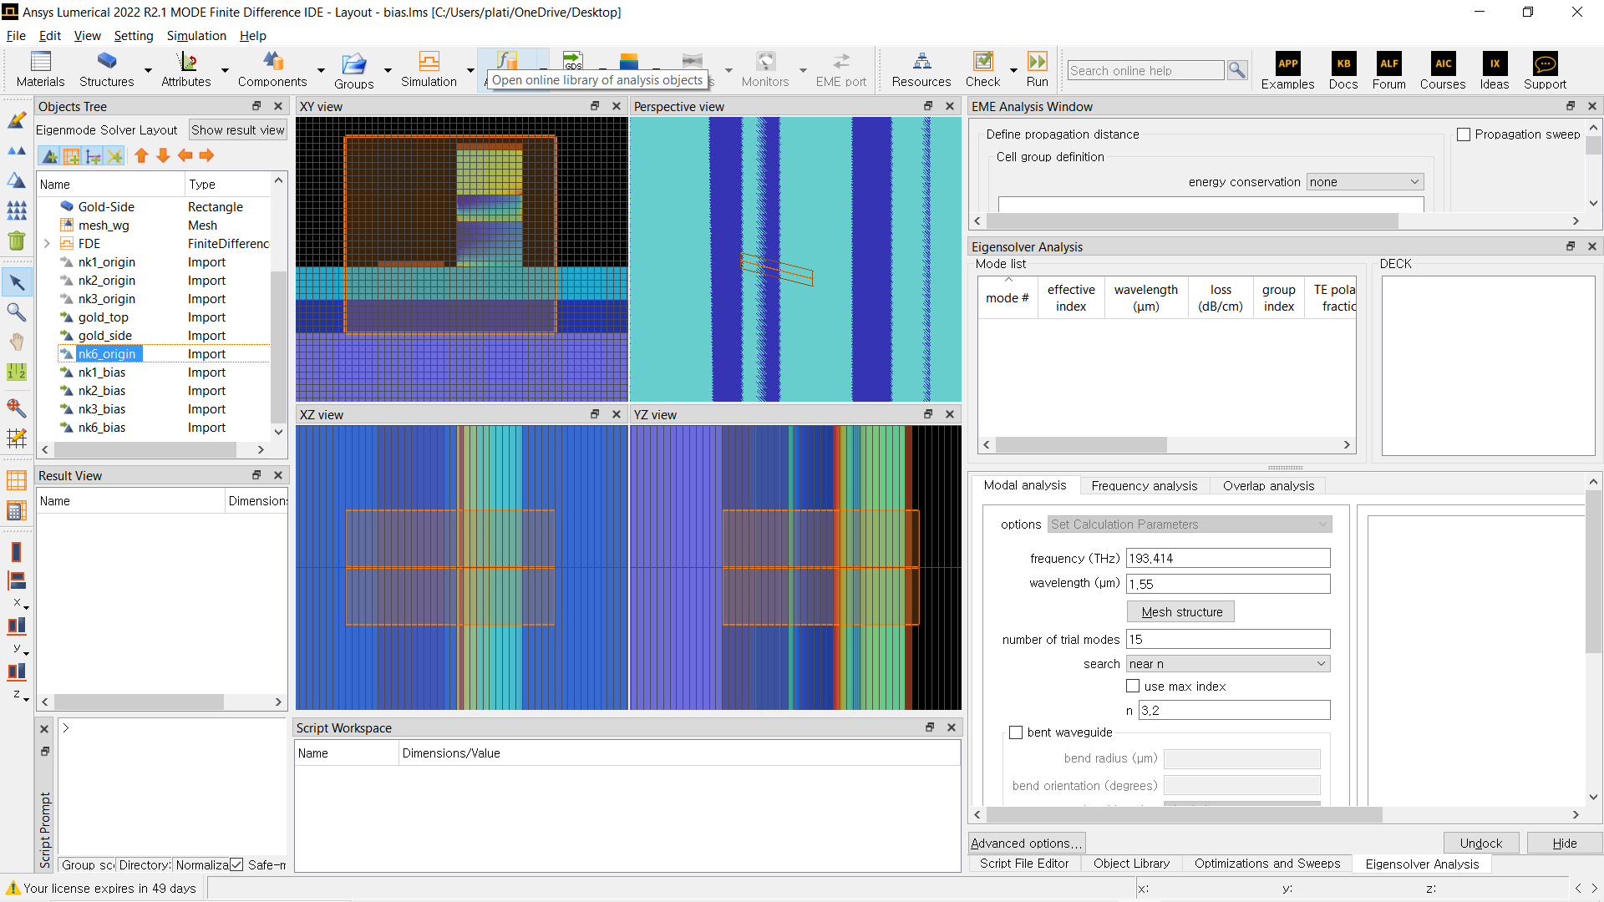
Smart Grid
If the grid area gets too big, it gets computationally heavy
Since I used setting.py variables to control the structures, making a computationally efficient gird area to calculate modes was possible. If the grid area gets bigger, it would be more accurate in terms of loss calculation, but also it gets computationally heavy. Therefore, using the smart grid, I could secure accuracy and computational power.

Slide 13
Smart Grid
Previously the code only used the red box area for computational efficiency, but it resulted in an inaccurate loss
The grid's width is wider than the blocks by an extra length of block width. The grid area height is higher than the block by an extra gold block height; Therefore, the grid area can always have enough space, including blocks we need for Loss calculation, even while the block width changes since the grid area also changes depending on the structure.

Slide 14
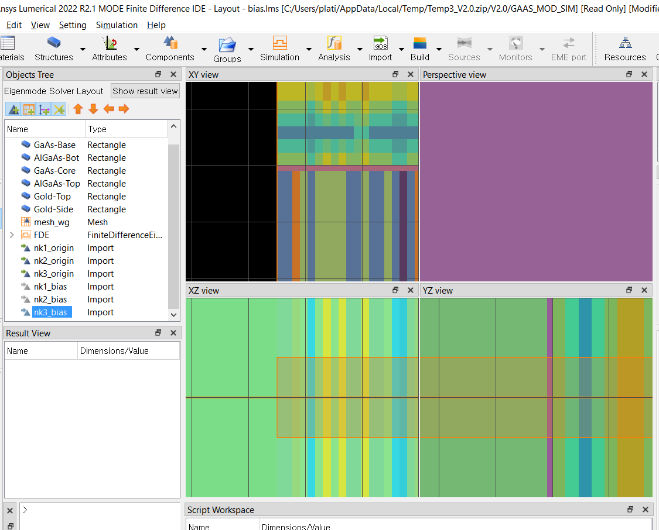
Grid Matching
The electric field’s boundaries didn’t match the structure boundaries in the old algorithm
The code with the previous algorithm was made to update the refractive index based on electric field vector boundaries. Because the electric fields’ boundaries didn’t match the structure boundaries , material refractive indices are skipped to be updated. (Where the color of the block looks purple in the XY view, that’s the boundary area)

Slide 15
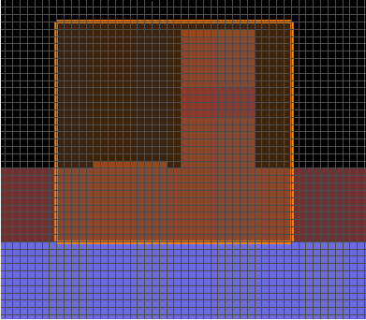
Grid Matching
The electric field’s boundary didn’t match the structure boundary in the old algorithm
The new algorithm uses block boundaries to assign refractive indices. Also, the algorithm uses an interpolation algorithm to calculate the electric field in the grid area accurately and uses it to calculate the changed refractive indices by the electric field.

Slide 16
Conclusion
In addition to the substantial updates discussed previously, my software incorporates numerous user-oriented features, such as automatic results generation and output text saving functionalities. Furthermore, I have endeavored to streamline each section of the code for enhanced usability. I would appreciate it if you could evaluate my program, provide feedback, and suggest areas for potential improvements.
Email address: sunghwanbaek0112@gmail.com

